Slide 1
Machine Learning
Machine Learning Introduction to Machine Learning by Kumar Anurupam is licensed under a Creative Commons Attribution-4.0 International License.
Single Sampled t-test
CS 3104 Fall 2019
Lecture Slides by Kumar Anurupam
Slides taken from the video “Statistics 101” by Brandon Foltz

Slide 2
Learning Objectives
After completion of today’s session you will be able to:
Implement t-test on a single sampled data.

Slide 3
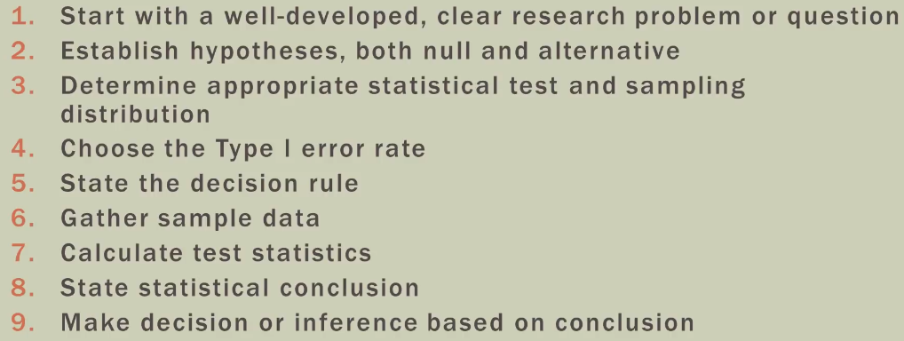
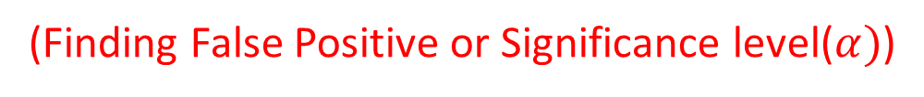
Hypothesis testing procedure
(Finding False Positive or Significance level($α)$)

Slide 4
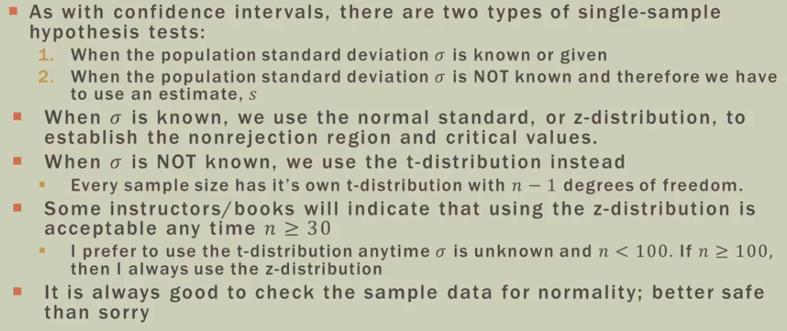
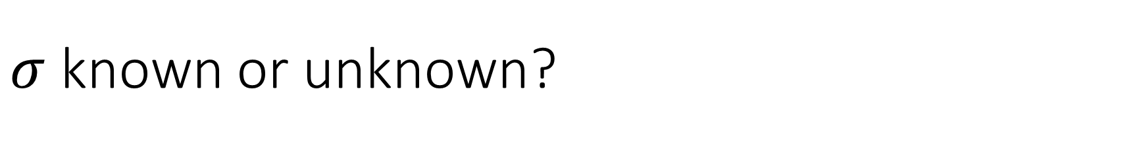
$σ$ known or unknown?

Slide 5
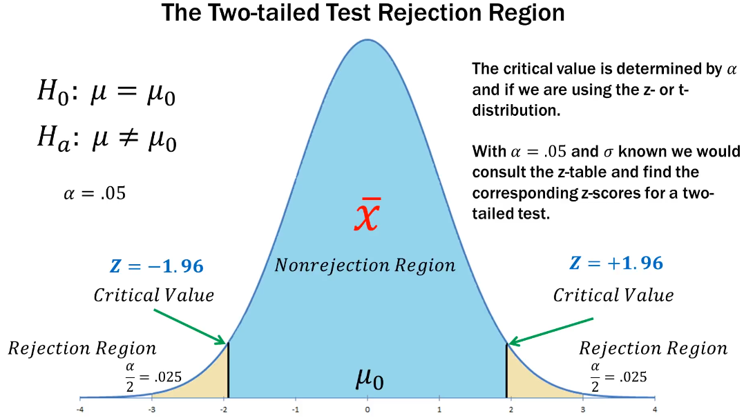

Slide 6
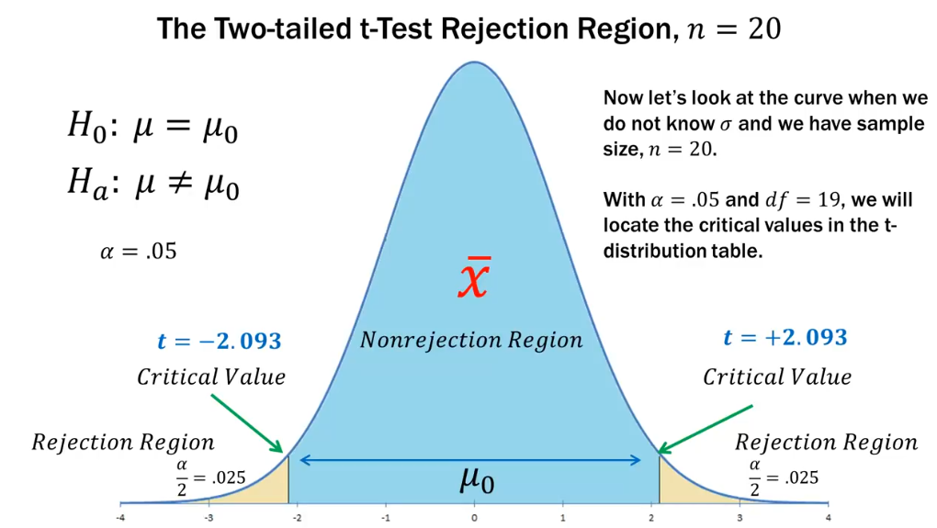

Slide 7
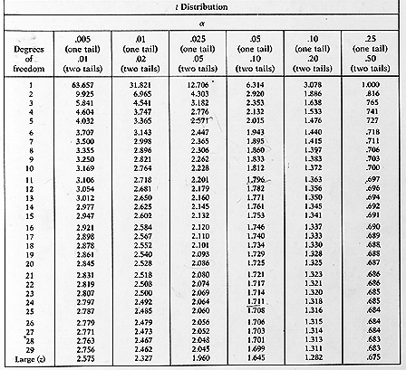
T distribution table

Slide 8
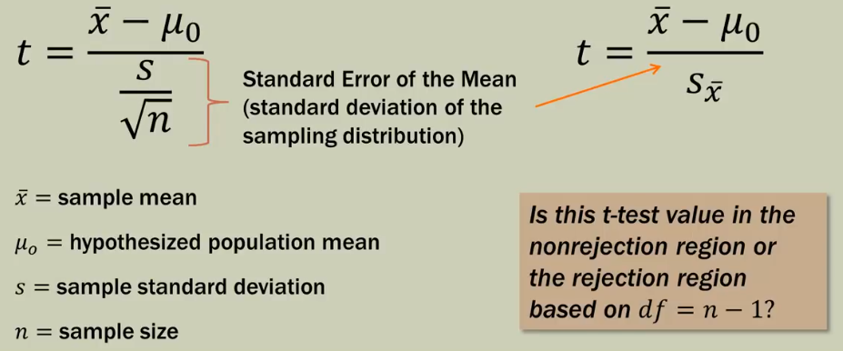
T test for a single mean

Slide 9
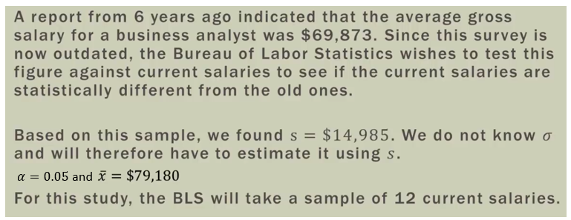
Numerical
Also, check if the sample is taken as 15.

Slide 10
Thanks

